Slide 1
Unit 2 – Intro to Program Development
Instructor: Brent Presley

Slide 2
Overview
Creating programs
Visual Studio
  Starting VS, saving a new project, solutions
The IDE (integrated development environment)
Form designer window
Objects
Icons
New project – six steps
Controls & labels

Slide 3
Overview
Code window
Adding code to controls
Switching views
Deleting excess event modules
Syntax
Testing/running programs
Adding comments & documenting methods
Object oriented terminology
Help system

Slide 4
Double click to open up notes on the right. This will show additional information

Slide 5

Creating programs
Language choice
  There are hundreds of languages
  The 10 most popular languages
    Java, C, C++, PHP, VB, Python, C#, JavaScript, Perl, Ruby
    Languages are built on a core set of commands
      Mathematics example, windows example

Slide 6
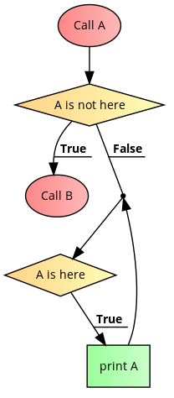
Creating programs
The languages are different, but the process is the same
Use an algorithm/pseudocode in the design phase
  Often times drawing it out will be helpful

Slide 7
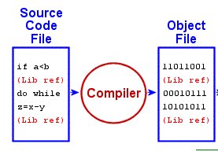
Creating programs
  Use an algorithm/pseudocode in the design phase, then convert into programming language
    Computers cannot understand these statements, only 0’s and 1’s.
    The compiler converts the programming language statements into machine language

Slide 8
Algorithm Example
Fantasy Football – how to choose the players you will draft?
  For each round..
    1- who is the best player
    2- what position do you need
    3- which players have the hardest schedule
    4- who do I want for a backup for bye weeks
  Do this until you have finished all rounds of the draft

Slide 9

algorithms
What is an algorithm & why should I care?
  https://www.khanacademy.org/computing/computer-science/algorithms/intro-to-algorithms/v/what-are-algorithms

Slide 10
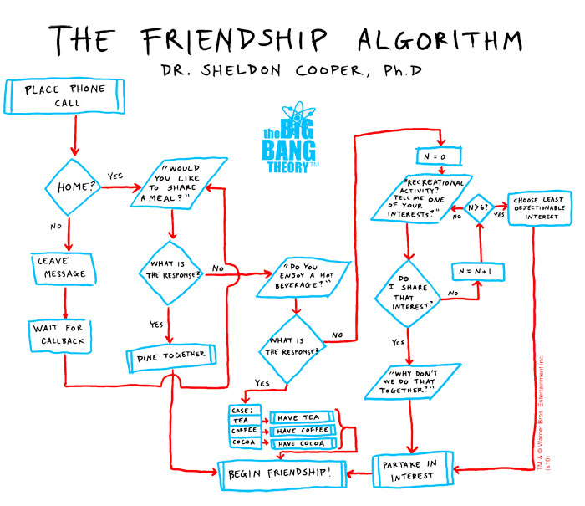

Slide 11

Creating programs
  The compiler also informs you if you have broken any of the rules of the language
  Compilers also optimize your code logic
    Compilers are packaged with other tools (editors, or debuggers)
Admiral Grace Hopper with a Univac-1 (1956)
http://designblog.nzeldes.com/2012/04/grace-hopper-as-susan-calvin/

Slide 12
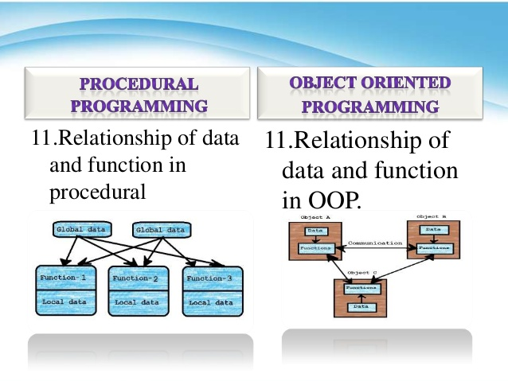
Creating programs
  Procedural vs Object-Oriented Programming
    Procedural
      step by step program that guides the application through a sequence of instructions in order
      Algorithms are executed with functions and data that the programmer has access to is able to change
    Object – oriented
      Each program is made up of objects
      Code is re-usable

Slide 13
objects
  An object is something you can see/touch/use
    programming objects: label, button, checkbox, menu
    Objects you can create: Person, student, building, purchase order, book, song
    Objects can be imbedded into each other. Similar to the layers on Earth.
      http://msascienceonline.weebly.com/uploads/6/9/0/7/6907936/5086541.jpg?518

Slide 14
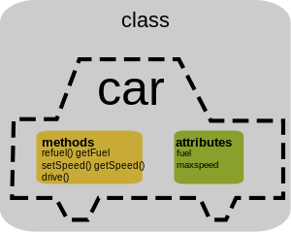
objects
  An object has the following:
    Attributes/properties-characteristics that describe them
      Object: car…
        attribute: color…
          value of color = red
    Behaviors – methods and events
      Method – action the object can perform
        Object: car…method: StartCar... Code inside this method will start the vehicle.
      Event – action the object responds to
        Braking, accelerating

Slide 15
Classes & objects
“In the real world, you'll often find many individual objects all of the same kind. There may be thousands of other bicycles in existence, all of the same make and model. Each bicycle was built from the same set of blueprints and therefore contains the same components. In object-oriented terms, we say that your bicycle is an instance of the class of objects known as bicycles. A class is the blueprint from which individual objects are created” - Oracle.com
  All objects of the class contain the same properties and behaviors…they have wheels, brakes, etc..

Slide 16
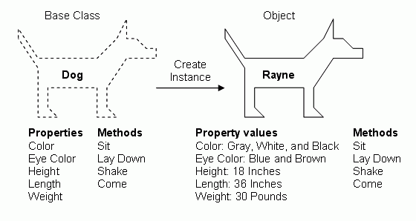
Class and Object relationship

Slide 17
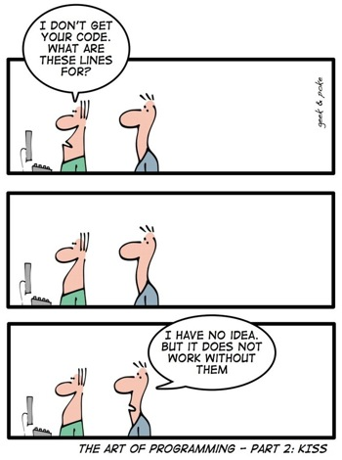
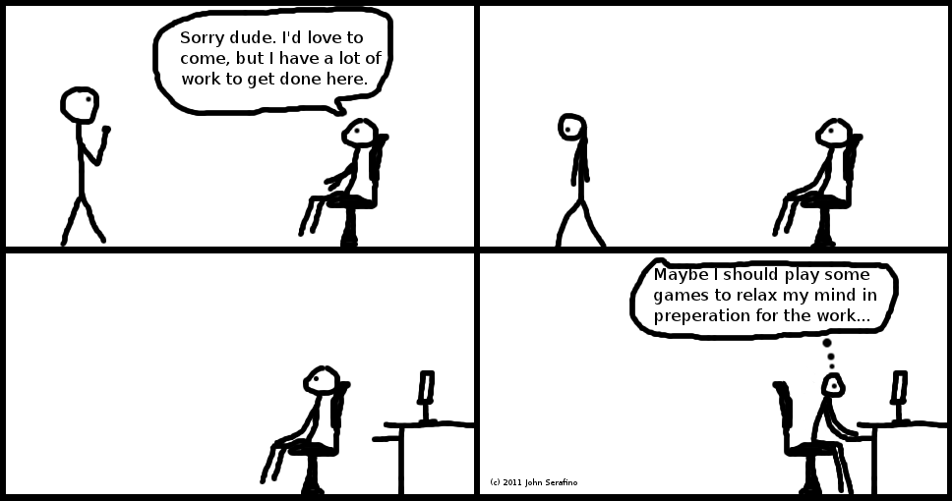
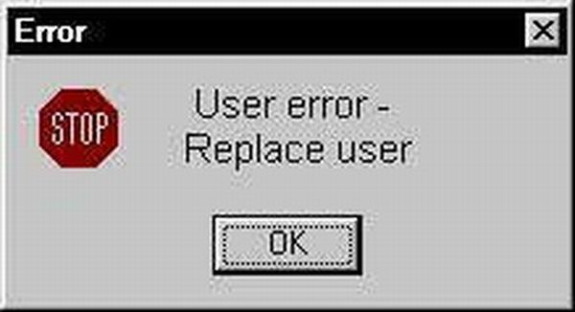

Slide 18

Visual Studio
  In this class (and Programming Logic - Intermediate), we’ll be using Microsoft C# 2013 (which is part of the Visual Studio software).
    This is already installed on your virtual machine.
  This software comes with an editor, a compiler, a debugger and a help system to help you learn the language.
    These components together are called the integrated development environment (IDE).

Slide 19

Visual Studio framework
  Microsoft .NET Framework 4.5.
  .NET framework is
    Platform on which applications are created
    Goal is to connect information, people, systems and devices.
    Supports C#, C++, Visual Basic and F#.
    Contains the common IDE
    Contains common set of classes shared by the above languages:
      Prewritten code for Windows components (form, toolbars, textboxes, etc).
      Common utilities – math utilities, string manipulation.
  For VS-.NET Framework must be installed on computers

Slide 20
Starting visual studio
Start visual studio
  Start page should pop up the first time. If not there click view…start page
Start a new project. Put it on the desktop, name it Sample
In the Start Page, click New Project…
In the left column of the dialog box that appears, select Visual C#
In the center column, ensure Windows Forms Application is selected.
In the Name text box, enter the name of your project. Do not keep the default of WindowsFormsApplication1. Change the Name to something meaningful to describe the project. (Note: follow standards/guidelines identified by the instructor).
Ensure the Location text box contains the correct location for your project. If not, click the Browse button and designate the correct location.
Click OK
The Start Page should automatically close. If not, close it by clicking the  on the Start Page tab. Be careful not to close the entire IDE.

Slide 21
visual studio
Just by creating the project you have ‘written’ tons of code
Click the ‘start’ button on the menu bar
  Window will move, resize, close, restore, etc..
The solution folder is now on your desktop
  Navigate to find it

Slide 22

VS file structure
  Sample – the Visual Studio solution file.
    This is what you open to work on a project
  You can just double-click this and the solution will open
    If you have more than one version of VS on your machine, you’ll need to open from within VS instead of using this shortcut

Slide 23
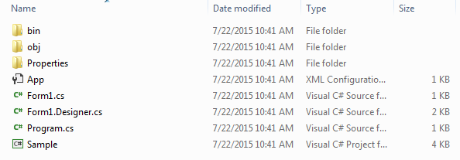
VS file structure
  Bin –hold binary files which are the actual executable code. When you want to share programs, share.exe files in the Bin/Debug folder.
  Obj – holds object or intermediate files which are completed binary files that haven’t been linked yet. Basically fragments that will combined later. They come from the compiler.
  Properties – contains the properties of this project
  .cs files – these are the actual text files that include the code
  Sample.csproj – has all the forms for this project catalogued

Slide 24




Solution Folder
Project Folder
Bin Folder
Debug Folder
Project Folder

Slide 25
Visual studio rules
Do not rename or delete the files. The project will not function properly
You can rename the actual shortcut on your desktop.
  Do so now.. Put your name at the beginning of the folder. Do this on all projects you submit.

Slide 26
Saving a project
Save your work often to avoid losing your recent work. To save the project:
  Option 1: Run the program. By default Visual Studio saves all the project files before running the program.
  Option 2: Click Save All button on the toolbar.
  Option 2: Select Save All from File menu.
  Option 3: on a windows keyboard..Press Ctrl-Shift-S on keyboard and follow above steps for location and Solution name.
    Ctrl-S saves just the one sheet

Slide 27
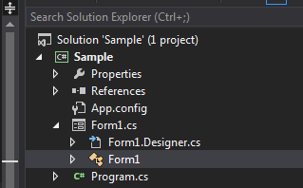
Look at the generated code
Solution explorer
  Form1.cs (the highlighted one). Review code
Notes:
Show solution, project, and files generated
Show extensions

Slide 28
Other VS files
Form1.Designer.cs – automatically generated code. Put there by VS
Program.cs – the main entry point for the application.
App.config – application configuration file. Defines things like the .net framework
References – libraries of code
Properties – project level properties

Slide 29
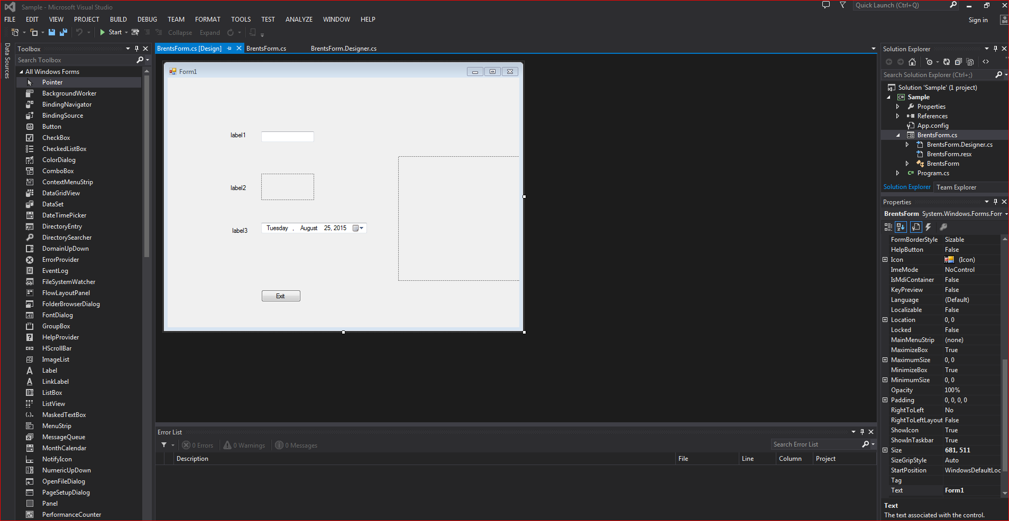
visual studio default windows
Solution explorer
Toolbox
Properties

Slide 30
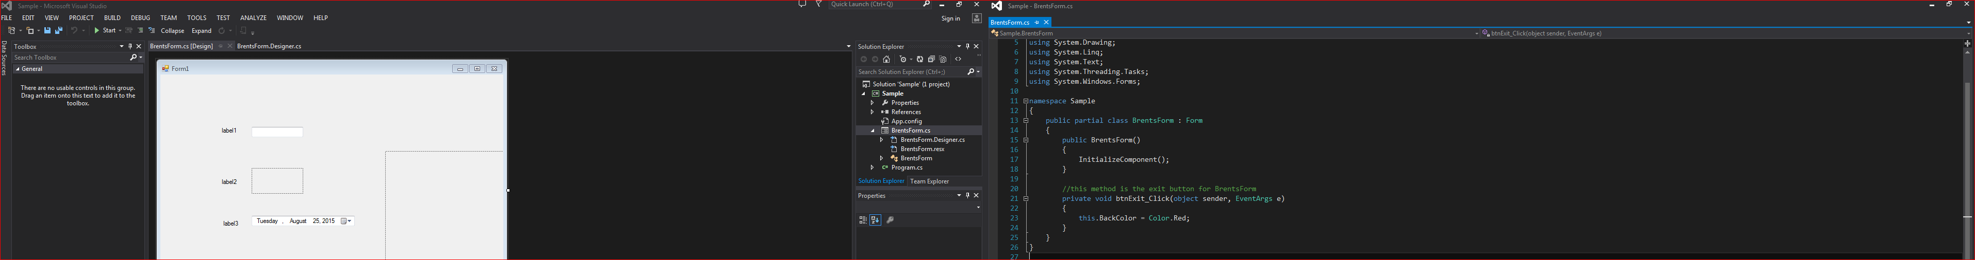
Docking and sliding windows
You can dock/undock and move windows around in vs
Autohide ability
Multiple screen ability

Slide 31

VS additional information
  Visual Studio NET includes the opportunity to combine many projects into a solution.
    Solutions are containers that can hold many projects.
    Each project could be written in a different language
      Used for large, multi-person system development
      MS Office might be considered a solution
    For our purposes, solutions will only have one project (but that one project must still be included in a solution)
    File extension for the solution is .sln

Slide 32
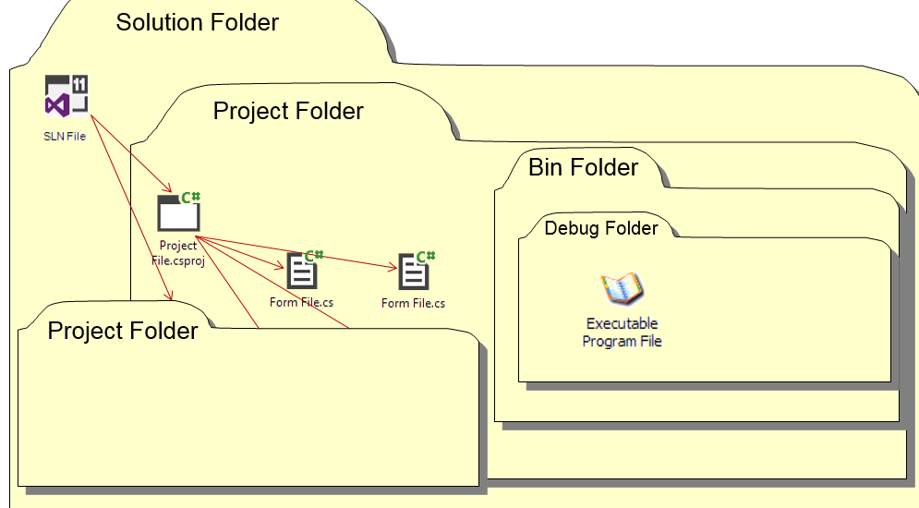
VS additional information
  All the source files for one program are combined into a project
    All project files are written in the same language.
    Projects must belong to a solution.
    The project folder is created and stored in the Solution folder.
    File extension for a C# project is .csproj. The project will be stored in a folder with the same name as the solution.
    Other files are created in the project folder as well.

Slide 33

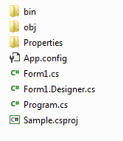
VS additional information
  C# programs include many source files.
    Code required to create forms and manipulate the objects on those forms
    Utility code used by more than one form or more than one program.
    File extension for C# source files is .cs
      Though its extension is .cs, you normally do not modify the Designer.cs files.
All source files are combined to form a project which is part of a solution (always).

Slide 34
Open Existing Projects
  You can open an existing project in (at least) 4 ways:
    Locate the .sln file using Windows Explorer and double-click it
    Open Microsoft Visual Studio. While on the Start Page, select the project listed in the Recent Projects list. The project will open (unless it was moved to a different location).
    Click Open Project… option and locate the project in the Open Project dialog box. Select the solution file (.sln) and click Open.
    Click File in the menu, click Open Project in the file menu and browse for the project using the Open Project dialog box. Select the solution file and click Open.
To open more than one project at a time, you’ll have to use the first option above (Windows Explorer) to open the second and subsequent projects in a new Visual Studio window.

Slide 35

Reminder - Course files on OneDrive
Go to OneDrive
  https://onedrive.live.com/about/en-us/
Access the student page
  Email address: mstcpresley@Hotmail.com
  Password: student2015
  This is where you will post your projects, obtain files

Slide 36

Customize Visual Studio IDE
Customizing the Visual Studio IDE document
  Link on my website, or OneDrive in Documents folder
Customizing sticks even after you close Visual Studio
  Will need to customize on all computers you use.
You will need to customize non-Mac lab computers every day because of the Deep Freeze program.

Slide 37

Import VS Settings, part 1
Download Brents VS Settings from onedrive (or from my website)
  From my website you may need to unzip the file
Importing Settings
  If you use multiple computers at home or on campus, you’ll have to update these settings on every computer
  Choose ToolsImport & Export Settings from the menu
  Select the Import selected environment settings option and click the Next> button
  Select the No, just import… option and click the Next> button

Slide 38
Import VS Settings, part 2
Click the Browse… button and navigate to locate the settings file above.
  Double-click the appropriate settings file. Then, click the Next > button
  Copy this file to your USB drive and access it from there for other machines
Click the Finish button, and then the Close button
Choose ToolsOptions and verify the settings described above have been changed.
  Note: The default project folder location has not been set because everyone’s default folder is different. Set the default folder at this time.

Slide 39
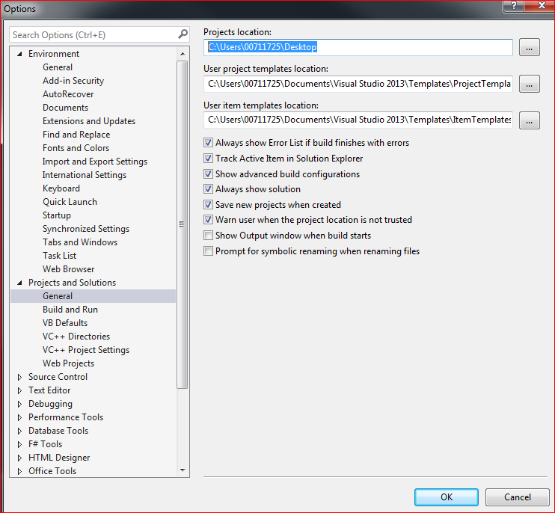
Set default folder
Tools….options…projects and solutions
GeneralProjects Location
Designates the where solutions and folders are stored by default
Suggest Desktop or USB drive.
USB drives may reduce performance.
  Work on Desktop, copy to USB when done

Slide 40
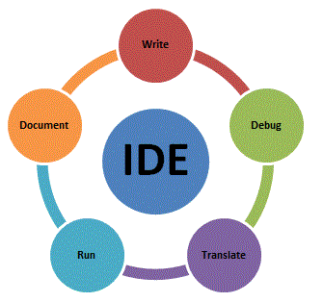
Managing the IDE
Dock
Undock
Resize
Auto-hide
Re-set window layout
Document- when setting up a project checklist

Slide 41
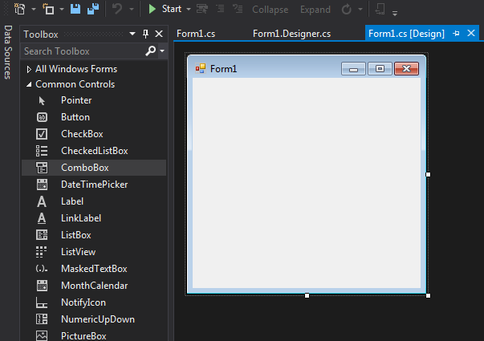
Windows form designer window
You create/design the GUI for the project using the Windows Form Designer.
  The form object is the foundation/container for the user interface in Windows applications.
  Add objects (controls) from the ToolBox (such as labels, buttons and text boxes) to the form. The form is an object itself.
  If the form is not displaying, double click on Form1.cs (or associated name) in the Solution Explorer to display the designer view.
  All objects have properties that describe the object. As you design your application, you can change the properties using the Properties Window. The properties can be ordered alphabetically or by category.

Slide 42
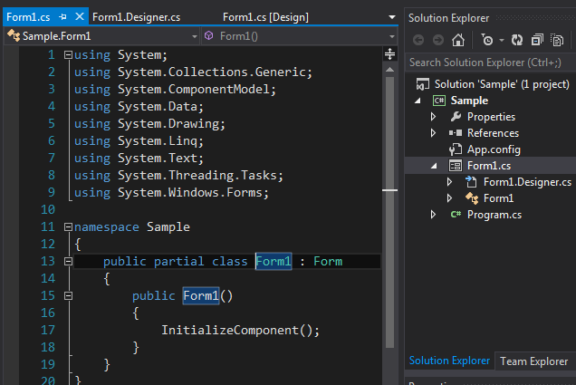
Changing form names
A source file is a file that contains program instructions or code. The Form1.cs source file is known as the form file.
  Contains the code associated with the Windows form object or form.
The first thing you should do is change the default name of the source file from Form1.cs to something more meaningful.

Slide 43
Changing form names
There are two ways to do this.
  1.Click on the Form1.cs to get focus. In the properties window, change the File Name property.
    IMPORTANT: include the .cs extension.
    Changing the source file name using the File Name property is the most convenient way to change the name of a form because it automatically changes the name of the form object as well.
DO NOT change the solution, project, or source file names from windows. Use Visual Studio to change the names.

Slide 44
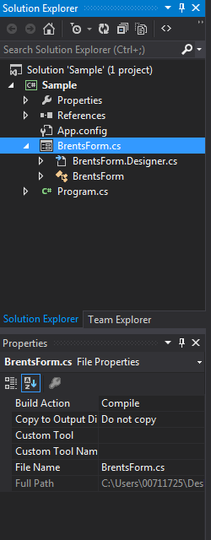
Naming objects
Objects that are referenced in code or by an event will need to be named. If the object requires an event procedure or the properties of the object are changed in code – rename the object from the default value.
Click on the object to select it
In the properties window, change the (Name) property.
Enter a descriptive name for the object
If property window is not visible, right-click object and click properties
Demonstrate name change after creating event handler

Slide 45
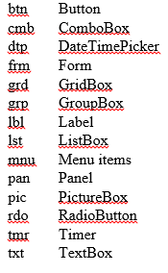
Naming objects
Enter a descriptive name for the object
  Our programming standards dictate all object names should begin with a prefix.
    The name begins with a 2-3 character prefix in lowercase followed by descriptive name to identify the control.
    The first letter of each word in this name is capitalized.
    Examples:
    frmSample, lblFirstName, txtAddress, btnExit, picLogo
    Refer to the class standard prefixes for a complete list. (course programming standards)
Note: If an object is NOT referenced in code or by an event, you can keep the default name.

Slide 46
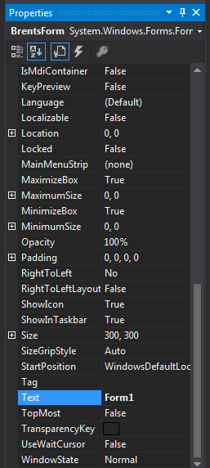
Form properties
Text – controls what appears on the form’s title bar. Right click- reset
BackColor – changes the background color of the form
  Note: when form’s background color is changed, the background color of all objects on the form whose background color is not set manually will adopt the background color of the form. Color is inherited by textbox, etc..
Change the text and the back color in your window

Slide 47
Form properties
Icon – set the icon that appears in the form’s title bar. Do not use default.
StartPosition - where the form appears on the screen (normally – CenterScreen)
Go to the internet and get an icon, download it to your desktop
Choose this icon for your window
Change StartPosition and see what happens

Slide 48
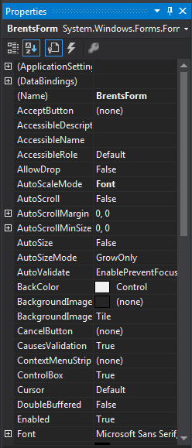
Form properties
Font – set the font (type, size, etc) for all objects on the form (unless those objects’ properties are set)
ForeColor - set the font color for all objects on the form
Change the font
Change the ForeColor

Slide 49
Form properties
BackgroundImage
  Select an image to display on the form’s background.
  Use the backgroundImageLayout for desired look.
Choose a background image (.png)
  Project Resource File, import…
Use this image, then change the backgroundimagelayout property
  Note: your project now has a folder called Resources into which the source image has been copied.

Slide 50

Steps to complete for every new form
Give a good name to the project
Change the file name from form1.cs to something meaningful
Change the title (text) of the form
Change the start position of the form to center screen
Change the form icon (must be .ico file)
Change the project icon (project properties)

Slide 51
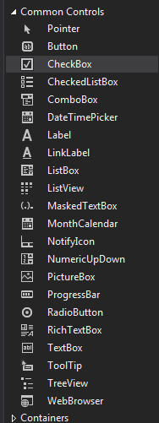
Adding controls
The toolbox contains the standard tools we will add to forms. In OOP terms, each tool represents a class. When you add an object to the form, they are called controls.
As a control is introduced in the notes, the common properties that are changed for that control are presented.
Note: if you change properties and want to reset them back to the original value, just right-click on the property and select Reset.

Slide 52

4 ways to add a control
Option 1:
  Double-click a tool in the toolbox
  Visual Studio will place a control of that type somewhere (random?) on the form
  Simply move (drag) the control to the appropriate position
Option 2:
  Click a tool in the toolbox and drag the pointer to the form.
  Release the mouse button when the pointer is appropriately positioned on the form.
Option 3:
  Click the tool and then click the form in the appropriate position
Option 4:
  Click the tool, then drag the left mouse button in the appropriate place on the form until the control is the desired size
Make 3 labels and note- the label & background color

Slide 53



Manipulating controls
Move control
Delete control
Sizing control
Select multiple controls
  Highlight them, shift-click, or control-click
  All objects = ctrl-a

Slide 54
assignment
Assignment: complete checkpoint page 62
  Work on this alone

Slide 55
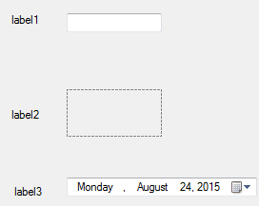
labels
Labels are used to:
  describe other objects on the form (what should be entered in this text box?)
  display information to the user (such as output results or directions/remarks)
Labels used to describe other objects or display information that does not change
  Not renamed (default name used) because code rarely refers to them.
Labels used to display results will always be used in code and must have a descriptive name (lbl prefix).
Add a label object to the form (see above)
Add code to Form1.. Label1.Text = “labelname”;
Notes:
Set title & text property = ‘program written by’

Slide 56
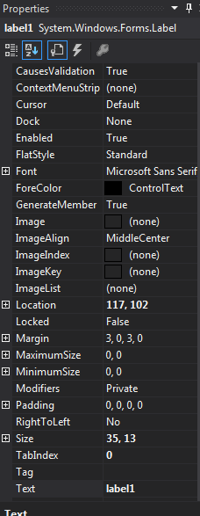
Label properties
AutoSize property of a label is set to True by default.
  Makes the label adjust to the size of the Text property contents.
  Gives the control a dotted-line rectangle called bounding box. This marks the tightest rectangle that contains all of the control and you cannot manually change the size of the label.
  To change the size, set the AutoSize to False
Notes:
Add mstclogo.gif as label image

Slide 57
Label properties
Image - to add a picture to the label , like MSTC logo
ImageAlign - control where on the label the image appears
Text - controls the words that appear on the label
TextAlign - control how the text aligns on the label (often in relation to an image location). Only appropriate if AutoSize is False.
Font - change the appearance of the label's text: font, style and size.
ForeColor - change the color of the text on the label
Change all of the above to see what happens
Notes:
Add mstclogo.gif as label image

Slide 58
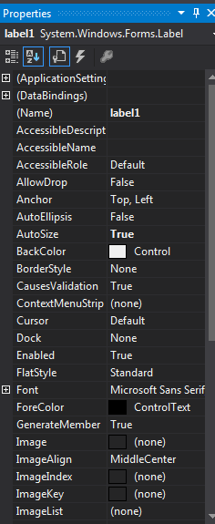
Label properties
BackColor - change the color of the label itself
  Labels are often transparent so the form's background shows through.
  Note: If a background Image was put on the form, the label takes on the background color and is not transparent. To make it transparent, select Transparent in the Web tab of the color selector.
Change the BackColor to be the same as the font and see what happens
Now choose a different color that is close, but not exact

Slide 59
Label properties
BorderStyle - set the kind of border the label has around it.
  Labels describing another control don't have a border
  Labels displaying output - set to FixedSingle
Visible - indicates if label can be seen on the form. Note this has no affect at design time—only when the program is running.
TextAlign – repositions the text within the label area.
  Test by changing autosize to false, then expand the label size.
Change BorderStyle and note the impact
Change AutoSize to false, make label larger. Change the textalign to see where the text ends up being placed

Slide 60

Label Tips
If you need many objects that have the same appearance (e.g. many labels with the same font size)
  Create one object and set its properties appropriately
  Copy the object to the clipboard
  Paste a copy of the object onto the form and position it appropriately
  Don't forget to rename the copy
  Make 3 identical labels with different names

Slide 61

Label Tips
Alternatively, after you’ve finished formatting one object, press the Ctrl key, point to the object and drag it to a new location
  A small plus sign should appear next the mouse pointer to designate you’re adding (copying) a control
  The new control will have the same format as the original but will be assigned a default name.
You can also place the objects on the form, select them all and change the properties for all of them at once.

Slide 62
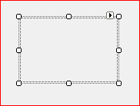
Picture box
Pictures improve the appearance of the form when used appropriately.
    NOTE: The form itself can have a background image but it can not be resized or repositioned.
Add a PictureBox to the form
Size and position as necessary
Note: the PictureBox is the first object we’ve used that includes a task list button (). This button gives you quick access to an object’s most commonly changed properties.
Download an image to your desktop, add it to the project and place it in the PictureBox object

Slide 63
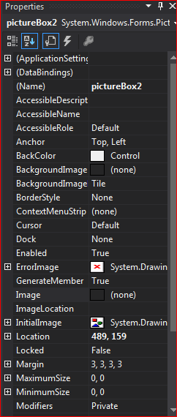
Picture box properties
Name - use pic prefix (if referenced in code)
SizeMode
  Normal: Picture is aligned top-left, as much of the image as possible displays
  CenterImage: the image centers itself in the box, as much of the image as possible displays
  AutoSize: the size of the PictureBox adjusts to accommodate the entire image
  StretchImage: the image will distort to completely fill the PictureBox
  Zoom (my favorite). The image will resize to fit in the PictureBox bounding box without distorting its shape.
Change these properties and note impact

Slide 64
Picture box Tip
Tip: Resize the image before inserting it into your program using your favorite drawing program.
  This prevents your program’s executable from being too large.

Slide 65

Picture box tip
Tip: Resize the image before inserting it into your program using your favorite drawing program.
  This prevents your program’s executable from being too large.

Slide 66
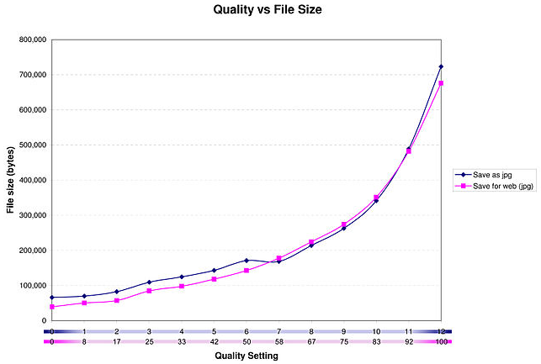
Impact of resizing image
Comparison of file size to qualilty

Slide 67
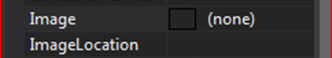
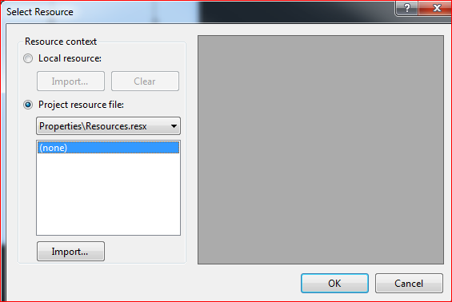
Picture box properties
  Image - designate which image should be displayed
  Local Resource
    This option copies the image and stores it as part of the form (in the form’s .resx file). Use if you plan to reuse this form in other projects, but not use the image elsewhere except imbedded in this form. Image is duplicated many times.
  Project Resource
    This option copies the image to your project’s Resources folder and links them in the project’s resources.resx file
    The advantage to this technique is the image file’s themselves are stored in the resources folder (not embedded in the form).

Slide 68
Picture box Resource choice
Don’t use project resource if you will reuse this form.
      Project Resource file allows you to use the same copy of the image in many forms, reducing the overall size of the project.
      When you copy the form, the Resources folder is NOT copied.

Slide 69

Picture boxes & animated gifs
    You can use animated GIFs in picture boxes. If you want to stop the animation, set Enabled to False
    Download a gif to your desktop, add it to the PictureBox and run the program to see it

Slide 70
assignments
Checkpoints 2.29-2.37 on page 91
  Complete on your own
Unit 2 - Worksheet (in assignments)
  Complete on your own
    Assignment: checkpoints 2.38-2.44 on page 104
      Complete on your own

Slide 71

Buttons
Buttons allow users to designate when program actions should take place
Properties:
  Name - use btn prefix (buttons must always be renamed)
  Text - change the words that appear on the button
  TextImageRelation – How the image and text of a button are positioned
Commonly modified properties:
location, size, font, forecolor, backcolor, image, imagealign, textalign
1.Add a button to the form
2.Size and position as necessary
3.Add an image to the button
4.Change TextImageRelation to see what happens

Slide 72
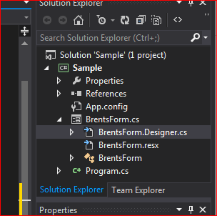
Code window
  As you know, everything you create using C# generates code.
  A lot of code is generated automatically by C#
    Code to create a form
    Code for every object placed on the form
    Hidden in the Designer.cs file for the form.
  Other code is entered by the programmer. Now we will generate some code.

Slide 73
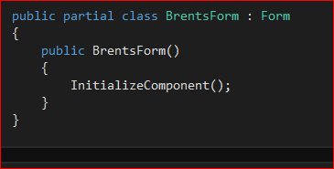
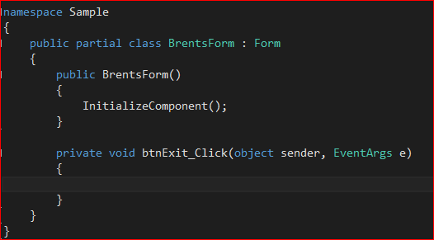
Code window
  To view the programmer code for a form, double-click on any object on the form or on the form itself.
    Be sure to name your object before generating code for it or the event procedure name will be incorrect. It will not be updated if you name the object later. If need be, replace the procedure name manually.
  Double Click creates an event handler
Creates this event handler

Slide 74
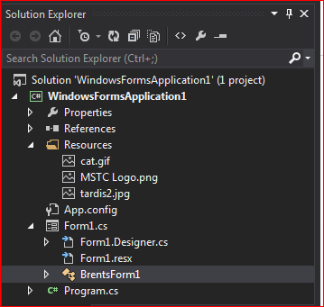

Code Window
The event handler most applicable to the object you double-clicked will be shown. The code template consists of the private void procedure header line and beginning and end curly brackets { }.
{curly brackets} are used in many programming languages to designate the beginning and end of a block of code (code that belongs together—is related).
Alternatively, you can click the View Code button <> in the solution explorer

Slide 75
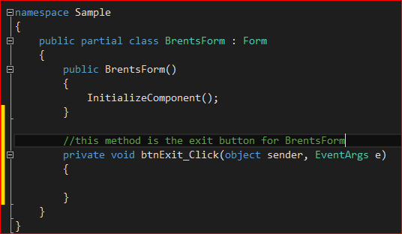
Code Window
Code Features
  Works a lot like a word processor
    Cut, copy and paste
    Drag to move or copy (Ctrl-drag)
  Color coding to make code more readable
    Reserved words in blue
    Comments in green
    Built-in classes in teal

Slide 76


Code window
Auto-indent
  C# uses the indentation of the previous line to set the indentation of a new line
  Press Tab to indent further, backspace to move to the previous indent
Auto-Curly Brackets Indent
  C# will automatically align the beginning and end curly brackets of a block after you type the end curly bracket.
  Tip: As soon as you type an open curly bracket, immediately go to the next line and type the close curly bracket. Then, type the appropriate code on the lines between them.
  Adjust where curly brackets appear: ToolsOptionsText EditorC#FormattingNew Lines

Slide 77


Event handler
The gentleman is the eventhandler
The woman (event generator) remembers who has registered for the ‘time service’.
When the event occurs, the event generator sends a message to the event handler telling them the event has happened. The event handler then carries out the task
http://csis.pace.edu/~bergin/Java/eventfundamentals.html

Slide 78
Adding code to a control
Objects know how to handle events..things that users do to objects.
Add code to the click event
Creating a click event by double clicking on the button
  Add this.Close() to event handler
    What is the line of code going to do?
  double click “OK” button.
  Run program

Slide 79

Change background color
Enter the following in the code window in the main method.
  this.BackColor = Color.Red
  What is happening in this line of code?
    Note intellisense and automatic formatting items
  Run the project, what do we think will happen when we click the button?

Slide 80
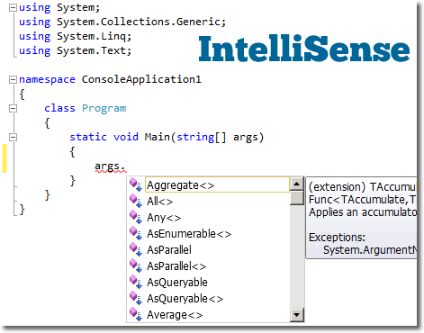
intellisense
Whenever you type code, C# automatically displays all the commands, classes, and variables that include (not necessarily begin with) the letters you type.
As you type more, the list is narrowed
This can greatly simplify entering long names
When the command, class, or variable you want is highlighted in the popup list, simply press Tab or the space bar to insert the rest of the text into your code.
If the intellisense list doesn’t appear (or to make it reappear), press Ctrl-Space

Slide 81

intellisense
Auto-List Members
  Whenever you refer to an object or a class, C# shows you the members and methods of that class as soon as you press a period (.)
  Select the value by pressing Tab or the space bar

Slide 82
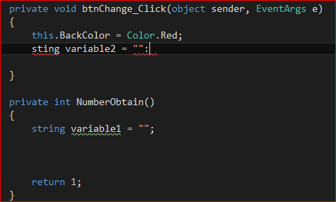
intellisense
Error Highlighting
  Just like when you make a spelling error in Microsoft Word, C# highlights syntax errors (language errors) by underlining the erroneous code with a red wavy line.
Unused variable highlighting
  Green wavy line

Slide 83
Switching views
You will be switching from the Code Editor to the Form Designer often.
  Simply click the appropriate tab at the top of the design window ( [Design] designates form design)
  If you're in form design, it's often more convenient to simply double-click an object to get to the Code Editor
  You can also use the Solution Explorer window.
    Click the View Code button <> to switch to the code window
    There is no design view button in the Solution explorer.. Double click the form icon to open Design View
Try to open code window and drag windows

Slide 84
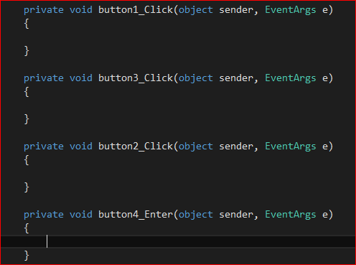
Deleting excess events
Occassionally, you’ll accidentally double-click a form object, creating an event handler for that object that you probably don’t need.
I don’t allow empty event procedures in completed projects.

Slide 85
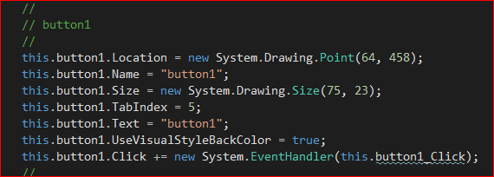
Deleting excess events
The best way to delete the empty procedure requires TWO steps
  Highlight the event procedure and delete it. This deletes the procedure, but leaves a remnant in the designer.cs file—the command that wires (links) the object to the code you deleted.
  Try to Run your project. Because of the remnant wiring command, you’ll get an error in the Errors window at the bottom of your screen. Double-click the error message. The designer.cs file automatically opens. Delete the remnant wiring command (the one with the squiggles under it)
  Close the Designer file immediately so you don’t accidentally change anything in it. Deleting these wiring statements are the only changes you should make to the Designer file.

Slide 86

Deleting excess events
You can also remove empty event modules by immediately undoing (Ctrl-Z). You’ll get a warning telling you you will be undoing code. Click Yes. Done.
CAUTION: This technique undoes all changes to the form/code that haven’t been saved.
    If this technique undoes too much, press Ctrl-Y (redo) to put it back again and then use the first technique.

Slide 87

Syntax rules
Syntax or language syntax, defines the correct way to use a specific programming language.
Syntax errors occur when you don’t follow the rules – C# can’t understand the command you’re trying to give. If a programmer violates C# syntax, the application will not run until it is corrected.
Most syntax errors are typing errors.

Slide 88

Syntax rules
A nice feature of Visual Studio is it checks for syntax errors as you are writing your code. When you move to the next line of code, the previous line is checked. If there is an error, a red wavy line. appears under the part of the statement that is in error.
  Hover over the line and it will tell you what the error is
  You cannot run the program until errors are fixed
Enter a statement into your form.cs and observe the lines.

Slide 89



3 types of errors
Syntax
Runtime
Logic

Slide 90

Error Types -syntax
Syntax errors
  Syntax errors represent grammar errors in the use of the programming language. Common examples are:
    Misspelled variable and function names
    Missing semicolons
    Improperly matches parentheses, square brackets, and curly braces
    Incorrect format in selection and loop statements
Just like in English…the words matter

Slide 91
Error Types - runtime
Runtime errors
  Runtime errors occur when a program with no syntax errors asks the computer to do something that the computer is unable to reliably do. Common examples are:
    Trying to divide by a variable that contains a value of zero
    Trying to open a file that doesn't exist
    There is no way for the compiler to know about these kinds of errors when the program is compiled.

Slide 92
Error Types - Logic
Logic errors
  Logic errors occur when there is a design flaw in your program. Common examples are:
    Multiplying when you should be dividing
    Adding when you should be subtracting
    Opening and using data from the wrong file
    Displaying the wrong message

Slide 93
Homework
Checkpoint 2.15-2.28 on p.77
Checkpoint 2.49-2.52 on p.108

Slide 94
Testing/running a program
While developing the project you will want to test your program.. Similar to lightbot
Click the Start Debugging button on the toolbar
  If there are errors, you will need to fix them prior to running
  Double click on error and it will take you to the location
To stop running- click on the stop button

Slide 95
running a program & fixing errors
Start a program and demo
  Syntax error
  Windows with information in them

Slide 96
Commenting code
  Comments are descriptions, added by the programmer, of the project as a whole or code in the project to further describe what the code does.
  To add a comment in C#, type two slashes ( // ) followed by the descriptive comment
    There can’t be a space between the slashes.
  The slashes can appear anywhere in a line of code (beginning or middle) but all text after the slashes is ignored.
  The comments will appear in green
  Another type of comment allowed in C# is a block comment.
    Block comments start with /* and end with */
    All text between the /* and */ is considered comments
    C# automatically adds a * to every line in between

Slide 97
Commenting code
  Types of Program Documentation
    Application level – describes the name of the project, programmer name, date, purpose and any changes made to the application.
      For now, enter the general program documentation in the code for the main form.
      Enter the comments above the using System; statement
      Use the following general program documentation for all projects in this course: (next slide)

Slide 98
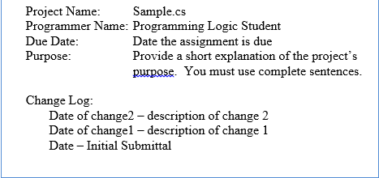
Comment header

Slide 99
Documenting code
Method documentation identifies the purpose of each method.
  For each method, provide a 1-2 sentence description of the method’s purpose (complete sentences)
Variables and Constants
  For each variable and constant (described in next unit), provide a purpose for the variable/constant using inline comments.
Code
For more complex blocks of code, provide internal documentation describing what the logic does.

Slide 100
Documenting methods
  To make program maintenance easier, programmers often add a description to the top of every method.
    There are numerous ways to document methods. The technique our standard dictate is to use a block comment that starts on one line, immediately followed by the method description, followed by the comment closing characters (*/) on the next line.
/* This method closes the form.
* This effectively ends the program.
*/
private void btnExit_Click(

Slide 101
Assignment
Checkpoint 2.45-2.52 p.106
Welcome Screen Program

Slide 102
Summary documentation
C# (actually every .NET language) allows you to create summary documentation.
  This documentation can be used to document a method.
  The big advantage is all the summary documentation can be easily combined to create program documentation in a separate file.
On the line above the method, type three, consecutive slashes (///)
  C# will automatically create a <summary> section
  /// <summary>
  ///
  /// </summary>
  /// <param name="sender"></param>
  /// <param name="e"></param>

Slide 103
Summary documentation
Insert your method description on the second (blank) line.
If your description is more than one line line long, simply press Enter at the end of the line and C# will insert another line with with the three slashes in place
  If the param and remarks sections appear, you can delete them if desired.
  What’s nice about this technique is when you collapse the code, the summary section collapses separately from the method and summary text (not the tags) are always visible.
Our standard is the block comment technique described earlier

Slide 104
More on object oriented
  Class - a pattern or blueprint used to create an object.
    Every object used in an object-oriented program comes from a class.
  Instance – objects created from a class are referred to as an instance of the class and said to be instantiated from the class.
    You can have multiple instances of objects from the same class in your application. (Ex: you can have 3 labels on your form, you can have 2 buttons on your form).
    Each object is uniquely referenced by its name.

Slide 105
More on object oriented
Encapsulation – hiding all the properties (data) and behaviors (methods and events of an object) in one package.
  By doing this, the programmer can use the class without having to know exactly how the class is coded.
  This is known as information hiding.
  (Example: you can drive a car without having to know how the engine, brakes and exhaust work internally. You can add a TextBox to your form without knowing the code needed to draw it)

Slide 106
More on object oriented
Inheritance – you can create one class from another class. The new class inherits the attributes and behaviors of the original class.
  A ComboBox inherits the traits of a TextBox and a ListBox

Slide 107
More on object oriented
Polymorphism ­ - an object-oriented feature that allows the same instructions to be carried out differently depending on the object and the situation.
For example: you can open a door but you can also open your eyes, open a jar or open a box.

Slide 108
Visual studio help system
The Visual Studio Help System is a valuable tool. Learn to use it!!
The easiest way to get help is to use Dynamic Help.
  Select the appropriate object in code or on the form.
  Press the F1 key on the keyboard
Visual Studio opens a new browser window (or a new browser tab) and displays the online help page for the object you selected.
I find Google to be a valuable resource

Slide 109
assignment
State information program

